Slide 1



Tree.io
Theme Name :
Enhanced Fire TV Experience
Team Members:
Tushar Sachdeva
Jai Bansal
Rohan Jhanwar
Nayan Jindal

Slide 2

The Problem
A Passive Experience
1
User opens Fire TV to relax, but is greeted with a sea of thumbnails. He just wants something that matches his mood. But how can the TV know that?
2
Suddenly, his friend in Paris texts: “Let’s watch something together?”
Sadly, there’s no way to sync playback smoothly so they give up.
3
4
Finally starts watching a thriller. Just when it gets good his mom calls. When he returns, he forgets what was happening. There’s no quick recap.
Days later, User is back on the couch. Still browsing. Still aimless. Still disengaged. Nothing engaging

Slide 3
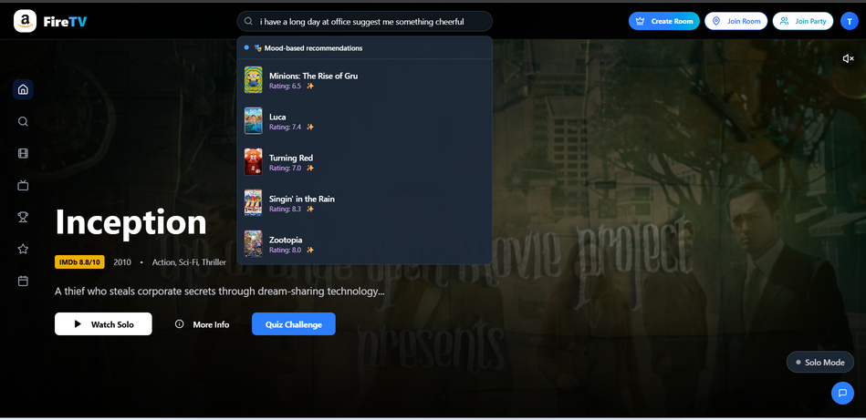

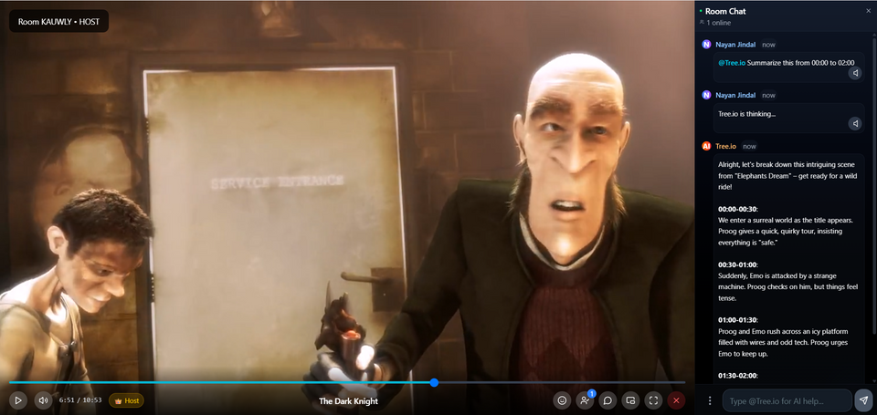
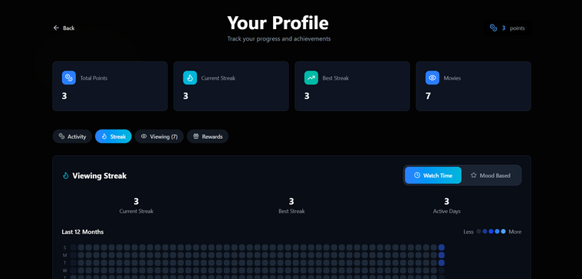
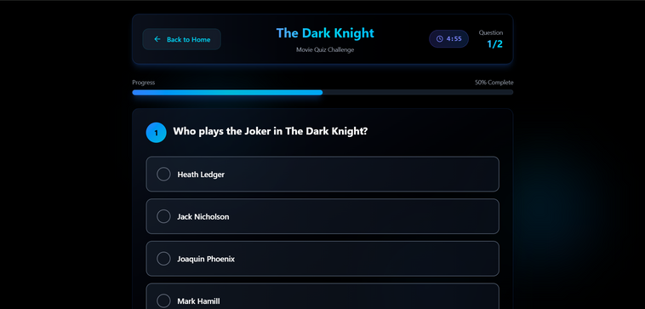
Solution
Mood Based Recommender
Co-Watching
Smart Summarizer
Gamification

Slide 4
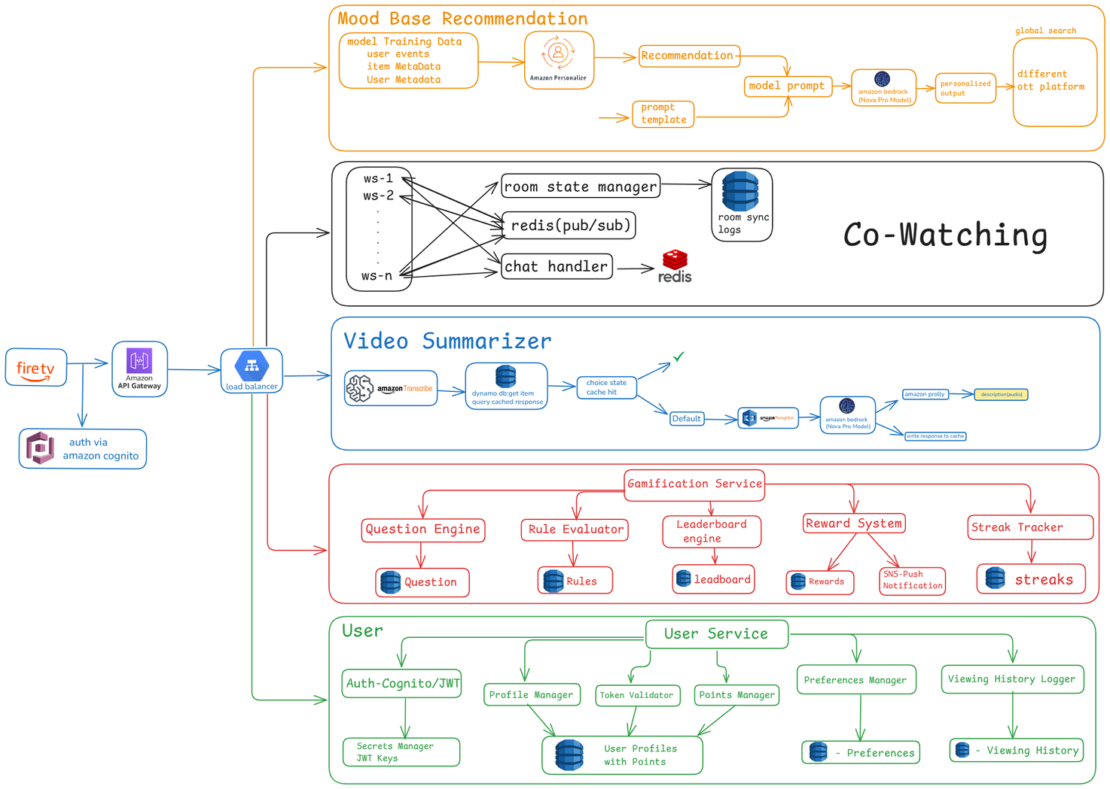
Architecture

Slide 5
Revenue Model
Freemium/Premium Model
Brand Partners
User starts with limited access and can upgrade to premium enjoying unlimited
co-watching and ad-free summaries
Reward users with points, streaks, and milestones for watching content , redeemable for coupons or offers from partner brands
Personalized Ads
Premium Content
Show personalized ads on Fire TV home or during content breaks based on user mood boosting advertiser value.
Suggest premium apps or channels based on user mood and earn commission on subscriptions or installs.

Slide 6
North Star Vision
Cross-Platform
Friends
Expanding smart summarizer and co-watching features across Amazon MiniTV, Audible, Chime, and Amazon Shopping.
Enabling leaderboards, progress sharing, and friendly challenges to boost user engagement and competitiveness.
Visual Summaries
Alexa Enabled
Expanding from text based interaction to voice-enabled, multilingual Alexa interactions.
Evolving from text summaries to dynamic video summarization

Slide 7
THANK YOU

